Slide 1
Software Engineering Instructor: Prof. waris ali
Created By :
Hamza Mehmood | Ahad Ali Zafar Junaid ul Hassan | Jibran Naeem
Anique Khadim

Slide 2
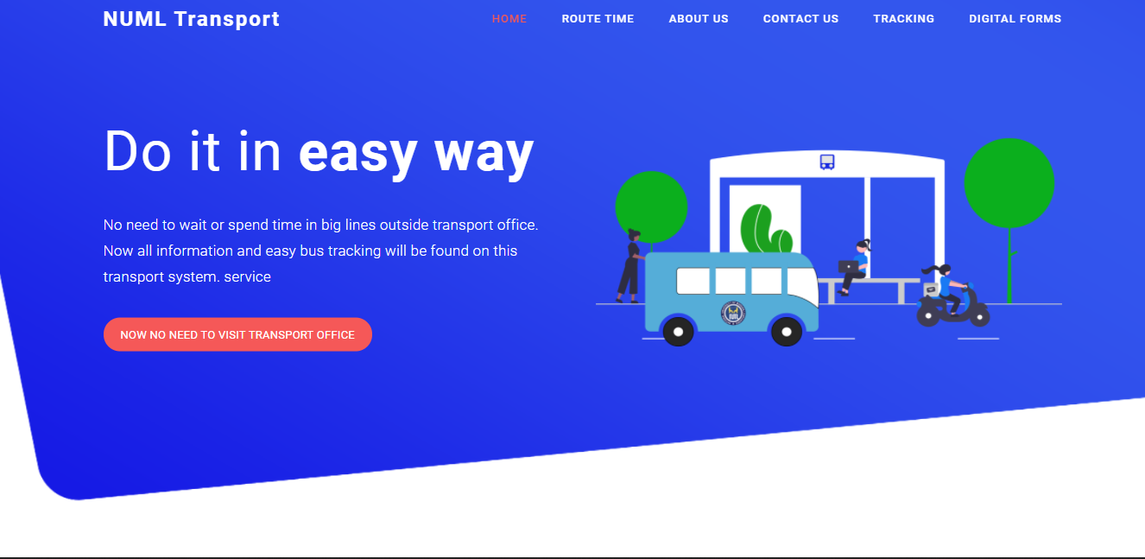
NUML TRANSPORT MANAGEMENT SYSTEM

Slide 3
Introduction
This is a web-related application that permits us to approach the entire knowledge regarding the NUML Transport Management, employees, students, faculties etc. This application is also called as NUML Transport Management System.
Following are the main Modules that we have worked on:
Admin Panel
Registration Process
Transportation Fees
Student, Faculty Info
Displaying Bus Schedule Info

Slide 4
WHY NEED OF THIS!
Today all the work at the time of taking transport services of the students is done manually by ink and paper, which is very slow and consuming much efforts and time.
Since the numbers of students is growing, and management has to handle records of all the students, it is facing a little bit problems in maintaining the records of students and other details.
It is required to Design of a Computerized Transport Management System, to speed up and make it easy to use system.

Slide 5
What we’ll get!
In our proposed system we have the provision for adding the details of the students. Another advantage of the system is that it is very easy to edit the details of the student and delete a student when it found unnecessary. Online updating and changes is possible.
By developing the system, we can attain the following facilities:
Easy to handle and feasible.
Easy to operate.
Cost reduction.
Fast and convenient.

Slide 6
What’s the Objective?
The main objective of this system is to reduce the consumption of time during maintaining the records of NUML Transport management. Separate divisions are provide to maintain the records of Student, faculty etc.
In other words the objective of the present NUML Transport management software are:
Simple database is maintained.
Easy operation for the operator of the System.
Faster execution & maintaining the records.
User interface are user friendly and attractive, it takes very less time for the
operator to get use-to with the system.
Our software will overcome all these "Safe, efficient, reliable, and sustainable movement of persons and goods over time and space".

Slide 7
What are the main scenarios!
The main scenarios Involved in This Application are:
Sign Up/Sign In to Admin Panel.
Filling the Required Forms.
Verifying The User Data and Clarifying Transportation Fee.
Generating Important Reports & Announcements.

Slide 8
USAGE OF SCENARIOS!
Login:
Login scenario is used to check whether the user is an authorized person to use the system or not. For this the user should give the correct user name and password.
The different types of users are:
Admin
Student
Employee/Faculty

Slide 9
USAGE OF SCENARIOS!
Forms:
This scenario consists of the following sub scenarios
Student/Faculty Registration Form
Student/Faculty ID Form
Student/Faculty Detail Form
Account Detail Form
Pick and Drop Points Detail

Slide 10
USAGE OF SCENARIOS!
Reports & Announcements:
All the above mentioned data are stored in the back end and can be retrieved as reports with filtering options. The Following are the reports can be taken from this system
Student/Faculty Report
Change in Schedule or Availability of Buses
Account Detail Report
Active/In-Active User Detail Report
Generate Pay Slip

Slide 11
Data flow diagram

Slide 12
Data flow diagram
Admin

Slide 13
DATA FLOW DIAGRAM
Admin

Slide 14
Use case diagrams
Including Actors(STUDENT,DRIVER,MANAGER) & Scenarios

Slide 15
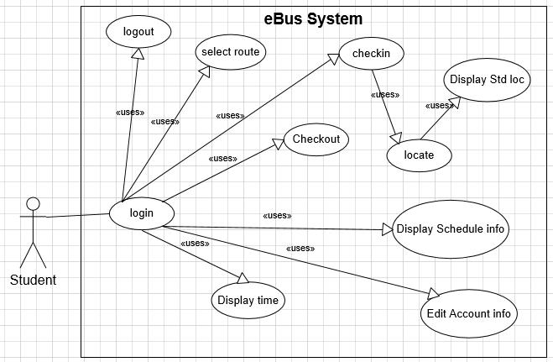
For Student
<<uses>>=<<includes>>
Student can Login to Admin Panel By Entering the Login credentials provided by University.
Student Can Register Himself for Transportation Service by Filling the form of Required Data According to his Desired Needs and then Print the Transport Fee slip Through Panel.
Student Can Find The Bus Schedule.
Student can Find the Timing of Bus.
Student can Track His Bus Current Location.

Slide 16
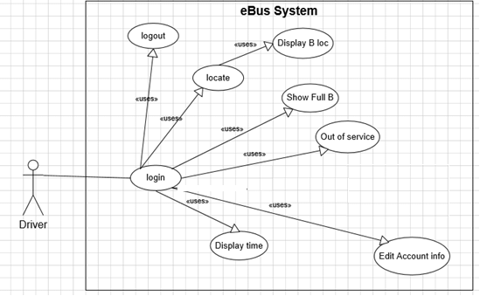
For driver
<<uses>>=<<includes>>
<<uses>>=<<includes>>
Driver can Login to Admin Panel By Entering the Login credentials provided by University.
Due to Change in Duty/ Schedule, Driver can Edit his Account info.
Driver can set & update his Current Location and Display it to Students.
(If-Happens) Driver can Report/Inform The Admin if the bus is Out of Service.
Driver Can Display The Departure Time and Arriving Time of Bus to Students.

Slide 17
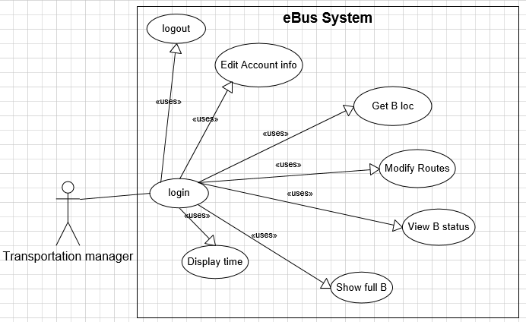
For Admin Manager
Manager can Login to Admin Panel By Entering the Login credentials provided by University.
Manager can Display All The Necessary Student Data to Drivers.
Manager can Set ,Update and Modify All the users Data, Required Information and Accounts.
<<uses>>=<<includes>>

Slide 18
Class diagram

Slide 19
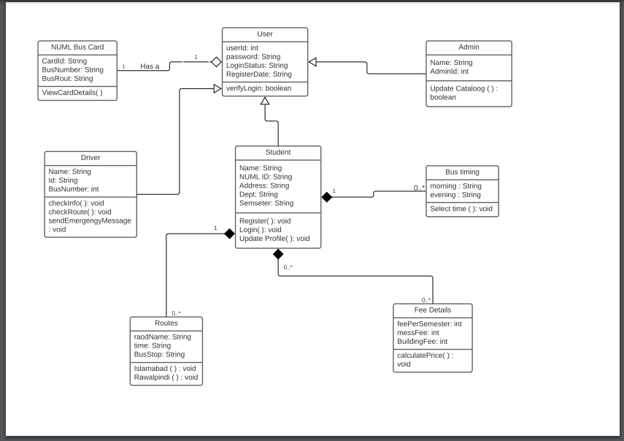

Slide 20
Sequence diagram
Including (STUDENT,DRIVER,MANAGER) & Scenarios

Slide 21
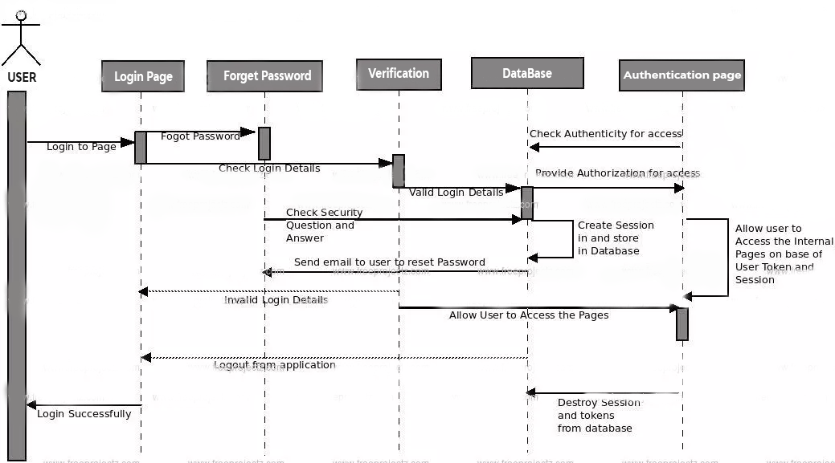
Login Scenarios

Slide 22
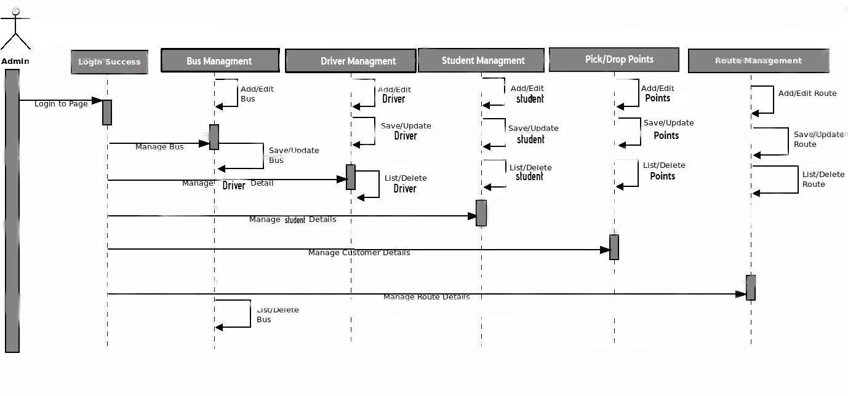
Admin Management

Slide 23
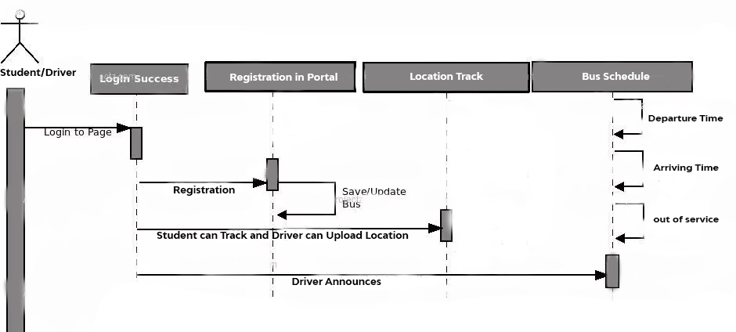
Student/driver Management

Slide 24

Implementation
We had to decide what programming languages should we use to design and implement this system. After discussing with all team members, we came to a conclusion of using the “JS React Framework” and “Laravel PHP Framework” to build our Software.

Slide 25
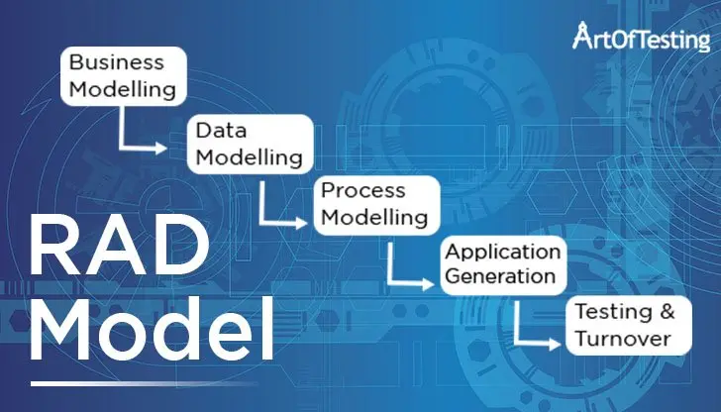
Model We’ve Used
As Keeping The Requirements of Software in Mind We’ve Used RAD MODEL Because RAD is a progressive development model that gives more importance to rapid prototyping and speedy feedback over a lengthy development and testing cycle. This model allows developers to make multiple iterations and updates to a software quickly, without the need to restart a development schedule from scratch every time.

Slide 26
In the absence of information, we jump to the worst conclusions.
That’s It!!!

